Slide 1
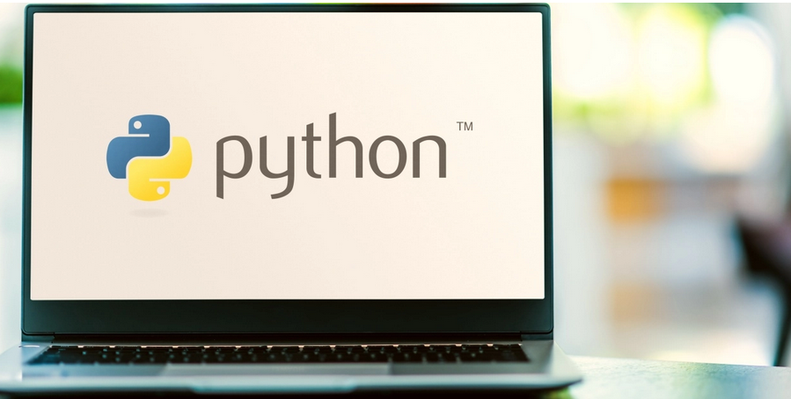

Slide 2
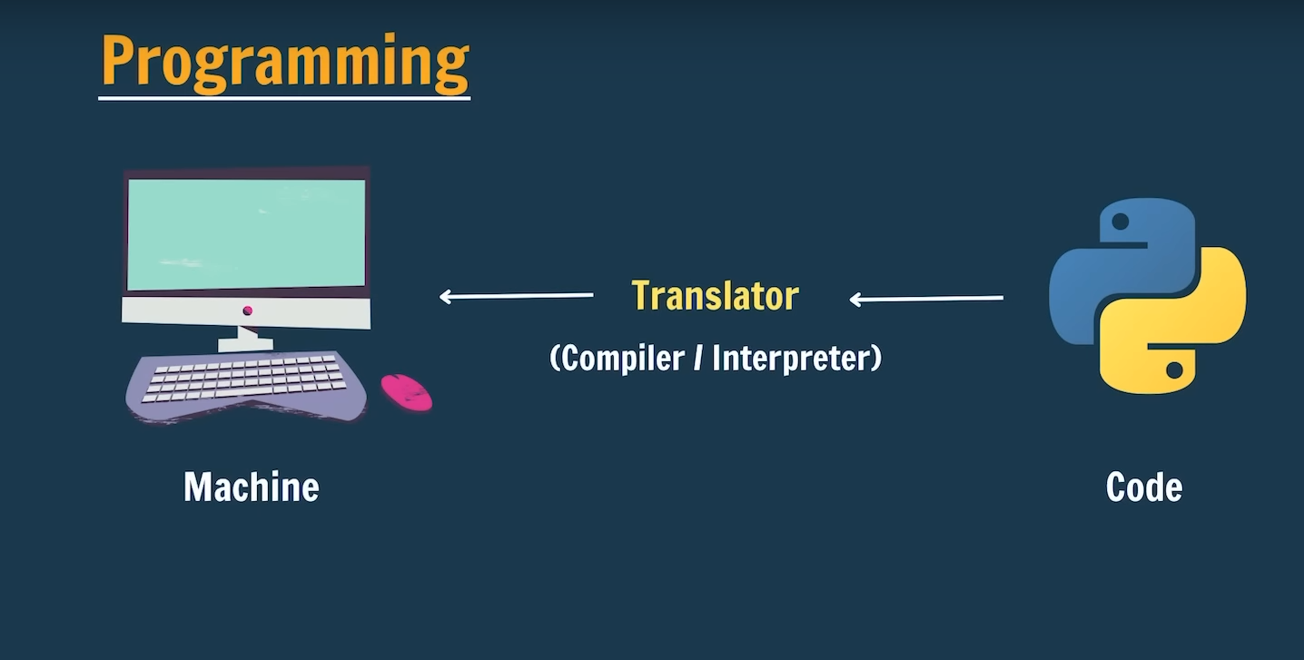

Slide 3
What is Programming and Python?
Programming is a way for us to tell computers what to do. Computer is a very dumb machine and it only does what we tell it to do. Hence we learn programming and tell computers to do what we are very slow at - computation. If I ask you to calculate 5+6, you will immediately say 11. How about 23453453 X 56456?
You will start searching for a calculator or jump to a new tab to calculate the same. This series will help you learn python from starting to the end. We will start from 0 and by the time we end this course, I promise you will be a Job ready Python developer!
What is Python?
Python is a dynamically typed, general purpose programming language that supports an object-oriented programming approach as well as a functional programming approach.
Python is an interpreted and a high-level programming language.
It was created by Guido Van Rossum in 1989.

Slide 4
Features of Python
Python is simple and easy to understand.
It is Interpreted and platform-independent which makes debugging very easy.
Python is an open-source programming language.
Python provides very big library support. Some of the popular libraries include NumPy, Tensorflow, Selenium, OpenCV, etc.
It is possible to integrate other programming languages within python.
What is Python used for
Python is used in Data Visualization to create plots and graphical representations.
Python helps in Data Analytics to analyze and understand raw data for insights and trends.
It is used in AI and Machine Learning to simulate human behavior and to learn from past data without hard coding.
It is used to create web applications.
It can be used to handle databases.
It is used in business and accounting to perform complex mathematical operations along with quantitative and qualitative analysis.

Slide 5
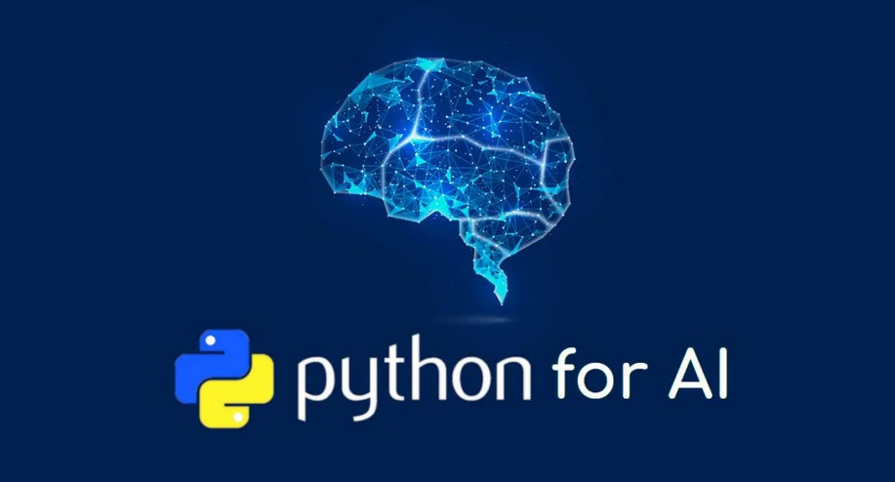

Slide 6
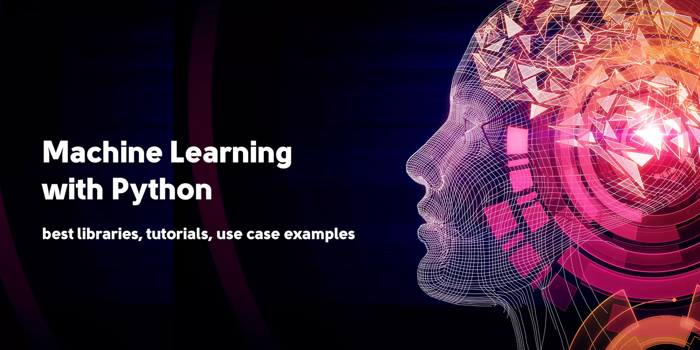

Slide 7
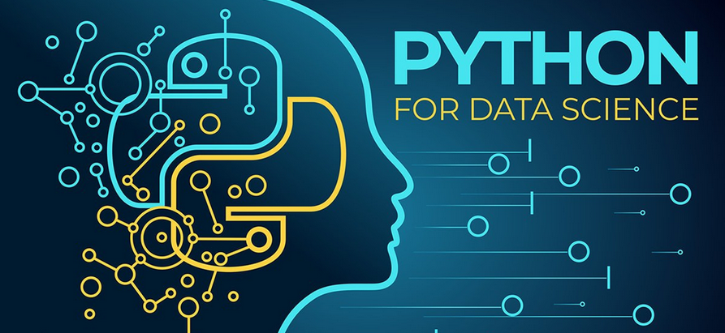

Slide 8
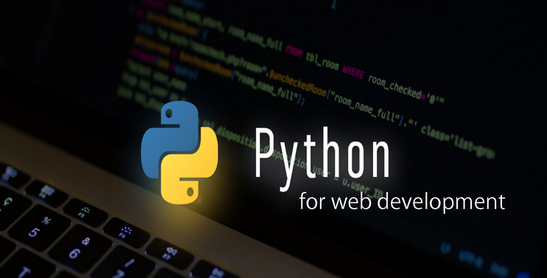

Slide 9
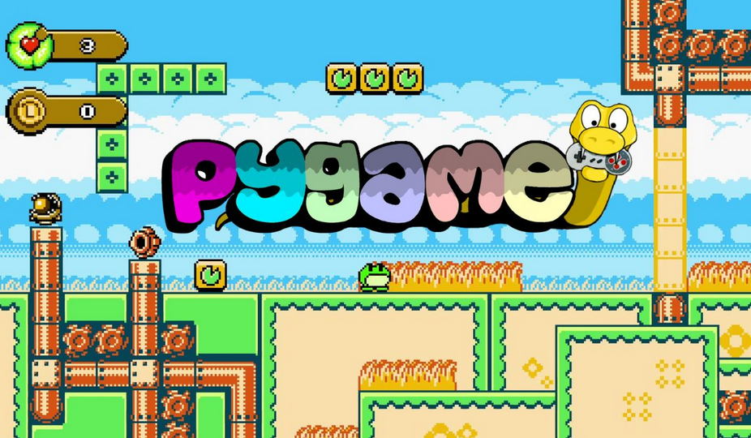

Slide 10
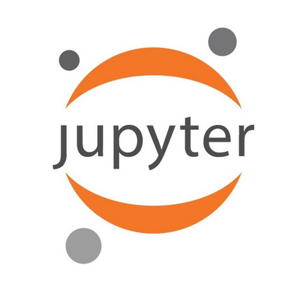
What is IDEs ?
In Python, IDEs (Integrated Development Environments) are software applications that provide comprehensive facilities to programmers for software development.
Why Jupyter Notebook ?
Interactive: Jupyter allows for running code interactively in cells.
Notebook Format: Code and text are organized in a notebook-style interface.
Visualization: Supports rich data visualization inline with code.
Kernel Support: Multiple language kernels available, primarily used with Python.
Sharing: Notebooks can be easily shared and collaborated on.
Extensions: Offers a variety of extensions for customization and functionality enhancement.
Educational: Widely used in education for teaching programming and data science.

Slide 11
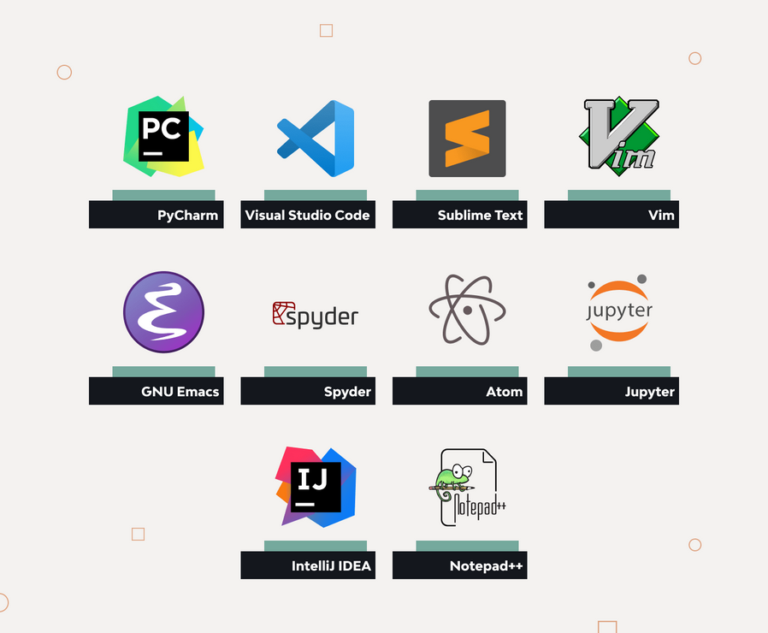

Slide 12
Our First Program
Today we will write our first ever python program from scratch. It will consist of a bunch of print statements. print can be used to print something on the console in python
Print(“Hello World”)
output
Hello World
Quick Quiz
Write a program to print a poem in Python.
print("---Your poem here---")
Please make sure you attempt this. Might be easy for some of you but please finish each and every task.

Slide 13


